Slide 1

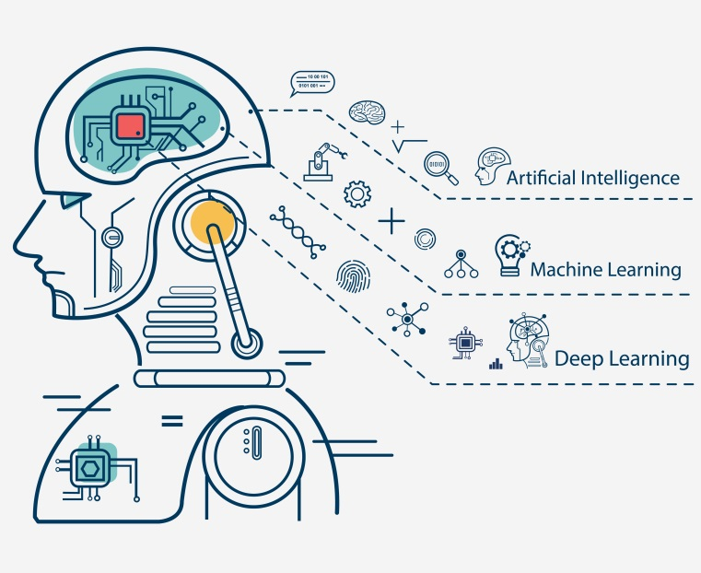
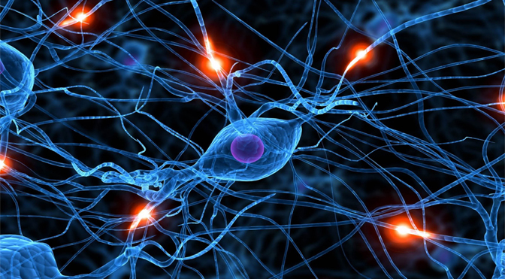
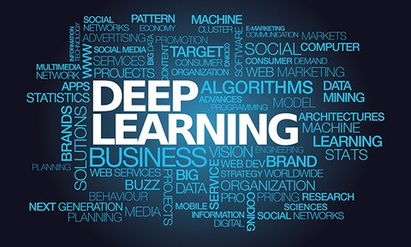
Introduction to Neural Networks
And Deep Learning
Zhao Yunkun

Slide 2
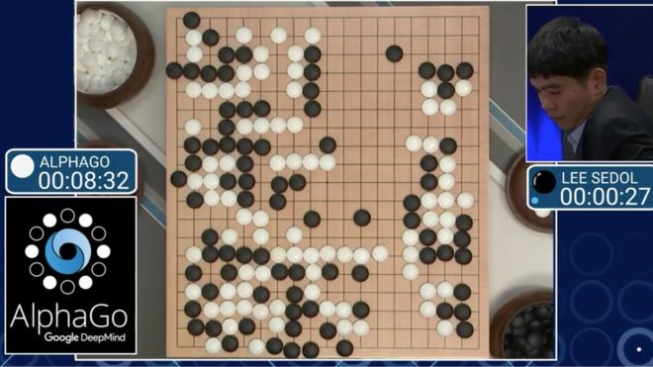
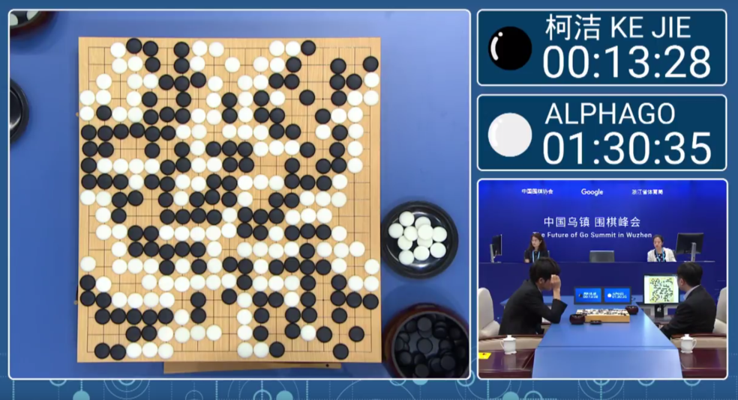
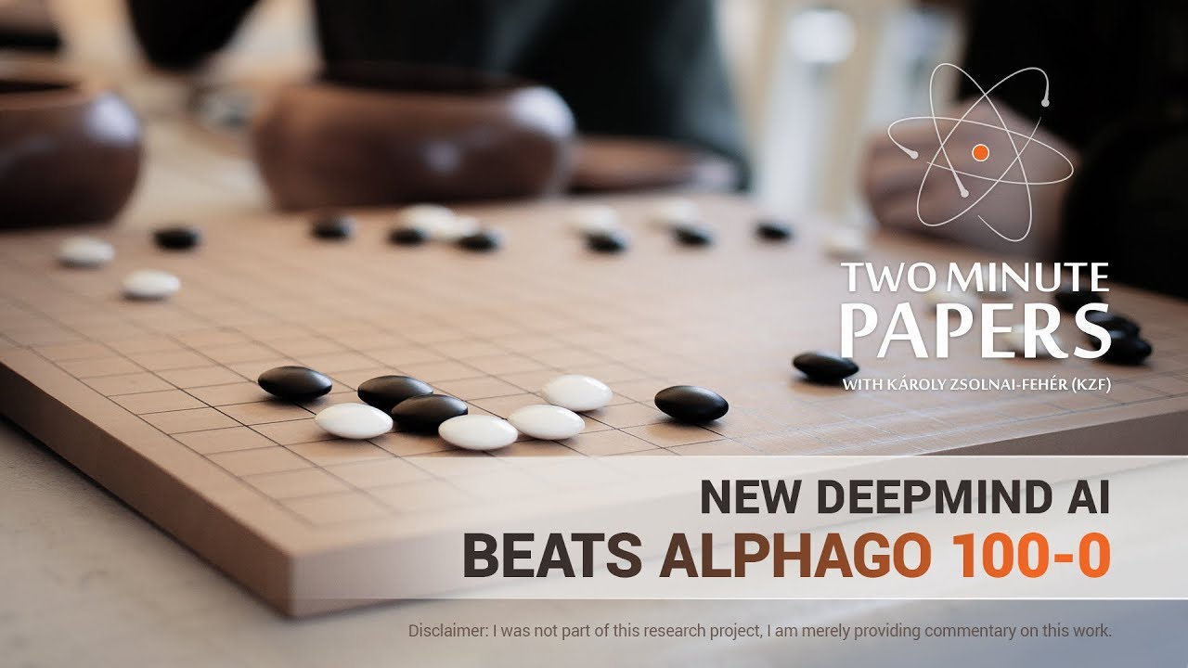
AlphaGo Defeats Best Players, But…
I
2016-03
AlphaGo(1.0) 4 : 1 Lee Sedol
II
2017-05
AlphaGo(2.0) 3 : 0 Ke Jie
III
2017-10
AlphaGo(2.0) 0 : 100 AlphaGo Zero

Slide 3


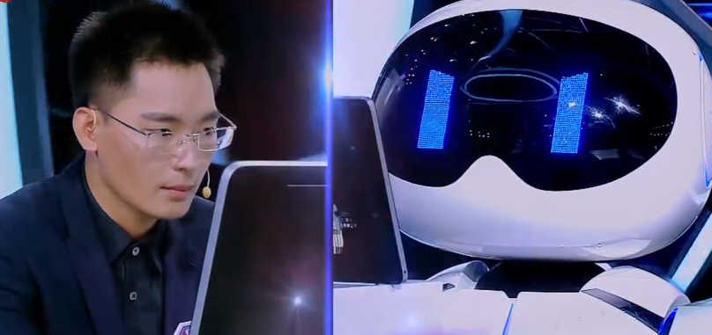
Baidu AI Brain Wins In Face-Recognition Competitions

Slide 4
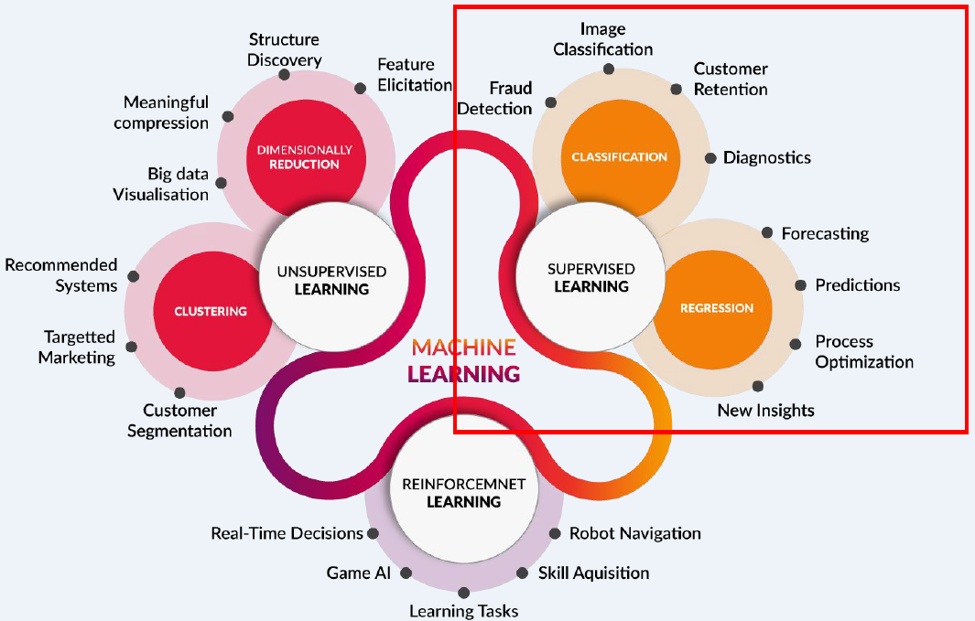

Machine Learning And Deep Learning

Slide 5
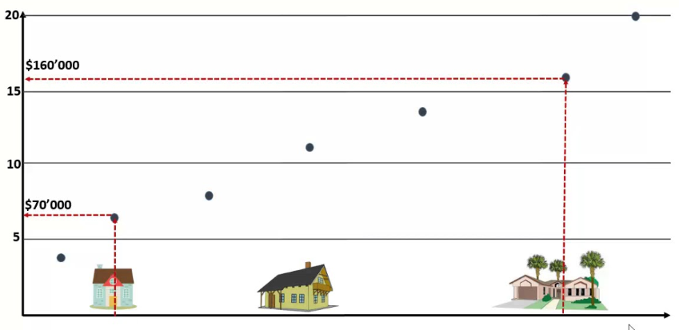
How Does Machine Learns ?
Example: Price Prediction With Regression
Size
Bedroom
Bathroom
Price
ID | Size (m²) | #Bed room | #Bath room | Price (k)
1 | 65 | 2 | 2 | 900
2 | 72 | 3 | 2 | 1200
…… | …… | …… | …… | ……
n | 50 | 1 | 1 | 500

Slide 6
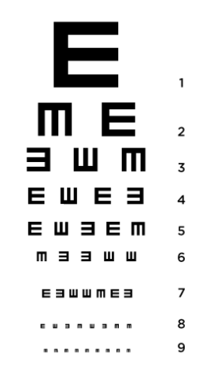
How Does Machine Learns ?
Machine
Learning (Not Memorizing)
Use algorithms to discover patterns in the data
Resource

Slide 7
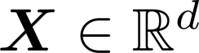
Machine Learning: Formalization
Input: (Housing information, e.g., size, #room, etc.)
Output: (e.g., Price)
Target Function: (Ideal price prediction formula)
f is unknown
Data: (Historical records)
Approximation Function (or Model ): (Min. in-sample/train error)
where in-sample error is
Goal of Machine Learning:
(Min. out-of-sample/test error)

Slide 8
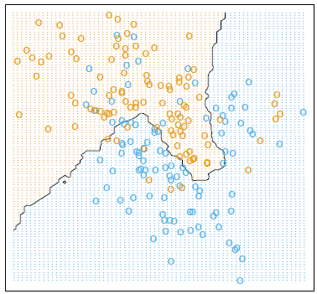
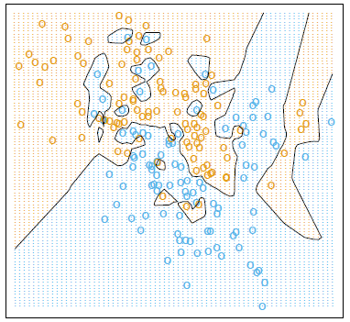
Machine Learning
Example: Simple Classification With Traditional Machine Learning Methods on
Nonlinear-Pattern Data
Underfit: Bias
Overfit: Variance
Y
Y
From ESL
From ESL
X
X

Slide 9
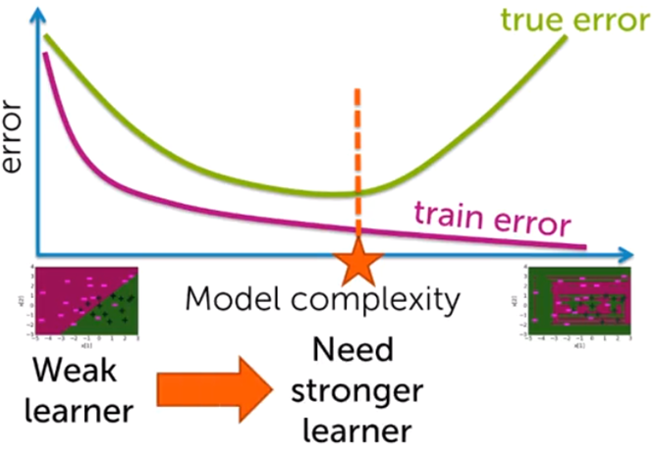
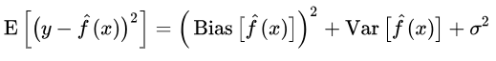
Traditional Machine Learning
Generalization Error Bound on Test Data (i.e., Out-of-sample):
M: reflects the complexity of model
N: number of training samples
ε: How much you can tolerate your
In-sample error to be different from
Out-of-sample error
♥
Bias-Variance Tradeoff
Underfit
Overfit

Slide 10

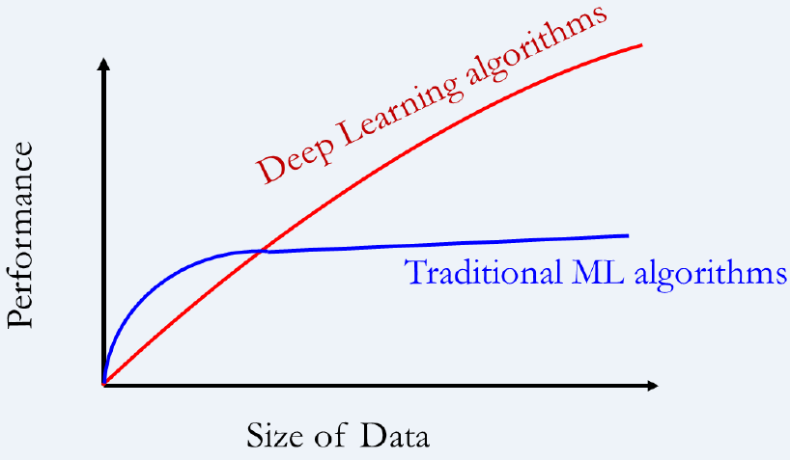
Traditional Machine Learning
Human brain is so great in learning, why not making machine learning mimic human train ?
Deep Learning doesn’t do different things, it does things differently
Deep Learning is self-adaptive

Slide 11
Deep Learning: Basics

Slide 12
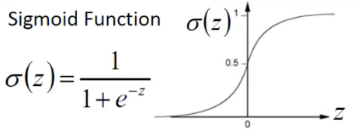
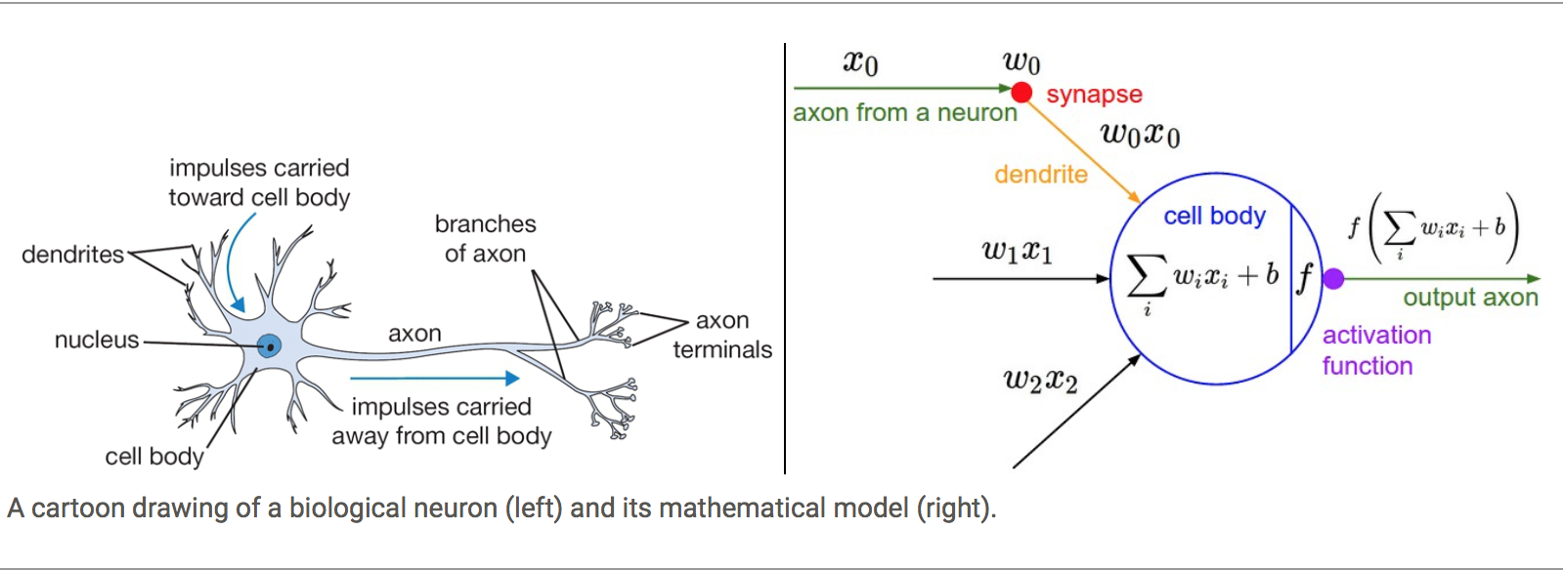
Deep Learning
How to Make Machine Learning Mimic Human Brain ?
Biological View
Neuron (or Perceptron): Information Reception, Process and Transfer
Hierarchical Structure: Multi-Layer and Multi-Level Inputs
Activation Function (Nonlinear): Nonlinear Reaction to Inputs

Slide 13
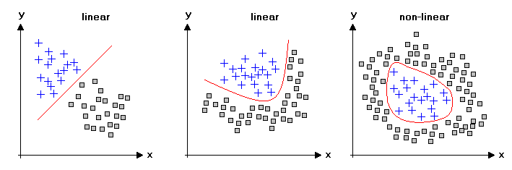
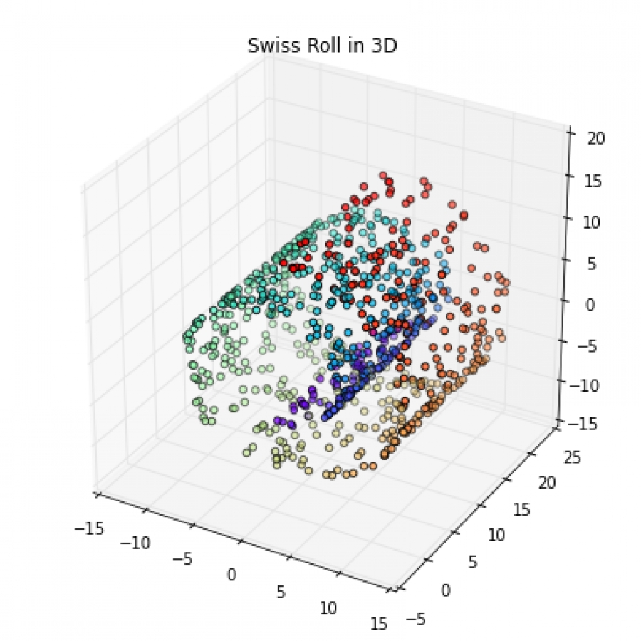
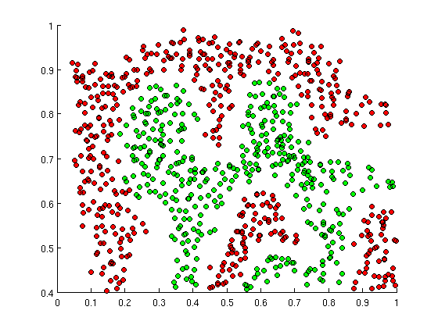
Neural Networks: Activation Function
How do neural networks learn nonlinear data pattern better ?
Nonlinear Activation Function
Nonlinear Activation functions are really important for NN to learn and make sense of something really Complicated and Non-linear complex functional mappings between the inputs and outputs. They introduce non-linear properties to our NN.

Slide 14

Neural Networks: Non-Linear Activation Function

Slide 15
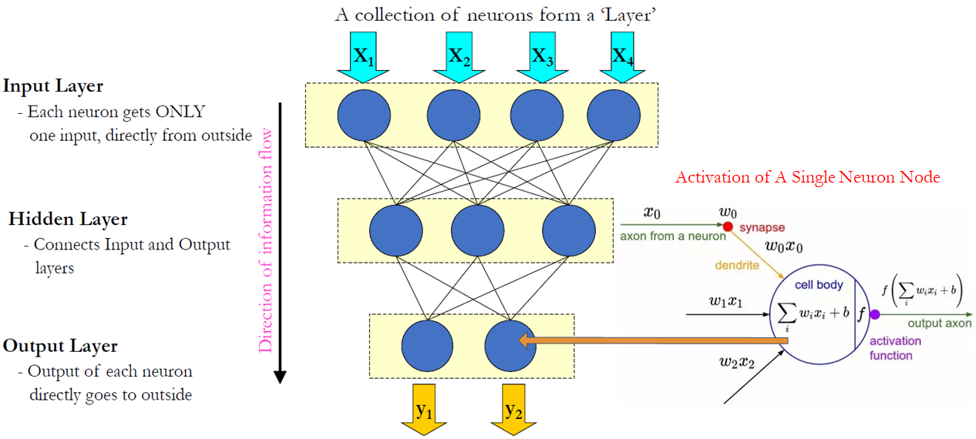
Neural Networks: Structure
Structure: Interconnecting Multi-Layers of Neurons/Perceptrons
Purpose: Learn these weights w_{i}

Slide 16
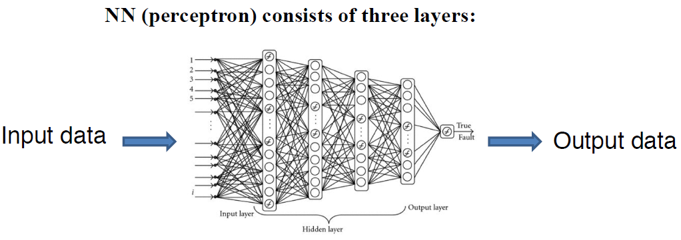
Neural Networks: Deep Neural Networks
Deep Neural Networks
Structure: Interconnecting Multi-Layers of Neurons/Perceptrons
Multiple hidden layers
Input Layer
Output Layer
Hidden Layers

Slide 17
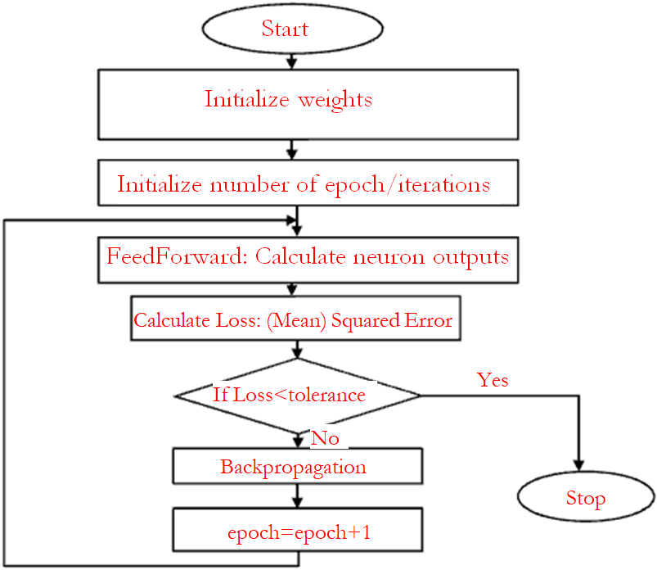
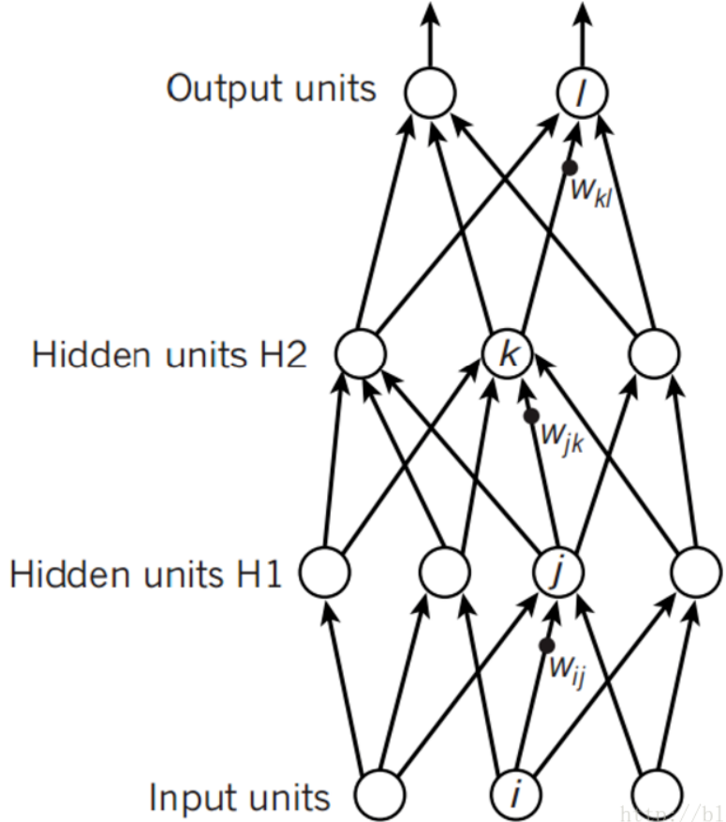
Neural Networks: Training Procedures

Slide 18
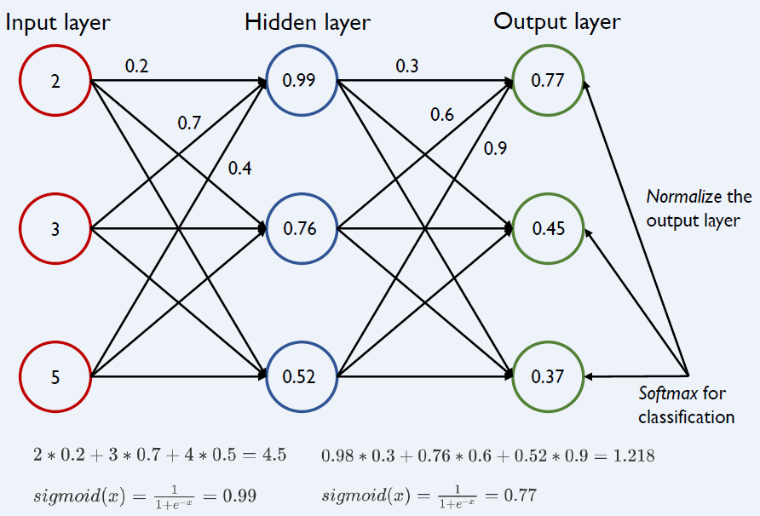
Neural Networks: FeedForward

Slide 19
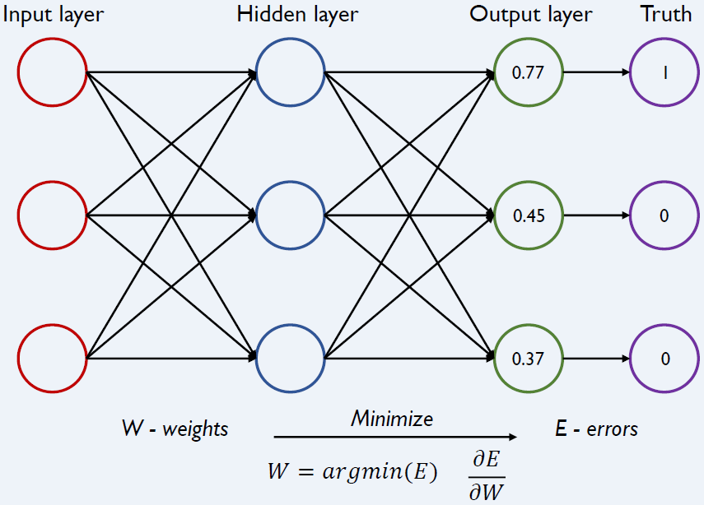
Neural Networks: BackPropagation
Q: Why do we need backpropagation?
- Reduce overall/total errors after updating weights
- Go back to update weights/parameters (Gradient Descent)

Slide 20
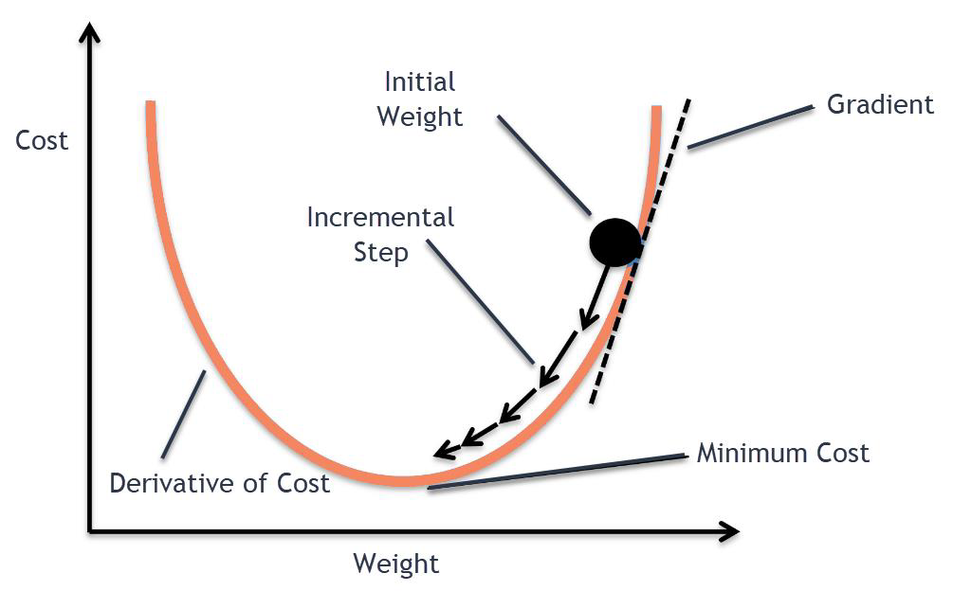
Neural Networks: BackPropagation
Gradient Descent
Update Rule:
Move in the direction opposite to the gradient direction, by a step with rate λ :
Here we need to decrease w_{i}. Note that gradient
is positive
Here we need to increase w_{i}. Note that gradient
is negative

Slide 21
Neural Networks: Summary

Slide 22
Neural Networks: Limitations

Slide 23
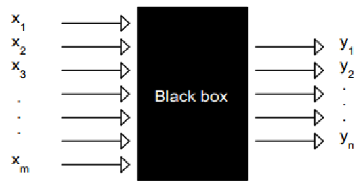
Neural Networks: Limitation I
Good at making prediction, but bad at making interpretation
What happens in the “Black Box”? The effectiveness of features ?

Slide 24
Neural Networks: Limitation II
Gradient Vanishing & Gradient Explosion
Derivative Chain Rule
Calculating gradient of weights:
If we choose activation functions carelessly,
If gradients are lower than 1 → Gradient Vanishing :
Solutions: Choose activation functions carefully
If gradients are greater than 1 → Gradient Explosion :
Solutions: Gradient Clipping; Regularization on weights
X1
h1
h2
hn
O1

Slide 25
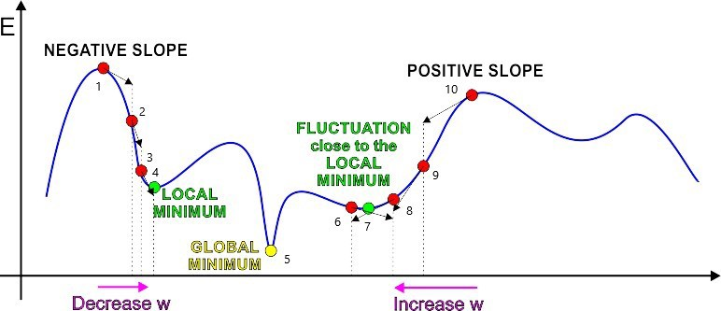
Neural Networks: Limitation III
Optimization With Gradient Descent:
Solutions:
Revised GD: Stochastic Gradient Descent (SGD), etc.
Alternative optimization methods: Simulated Annealing in Boltzmann Machine
Remember:
Gradient Descent is a greedy algorithm

Slide 26
Neural Networks: Limitation IV
Generalization Error Bound on Test Data (i.e., Out-of-sample):
♥
Neural Networks may still overfit !
General Solutions:
Regularization on weights
Batch normalization
Dropout neurons randomly in each layer
Bias-Variance Tradeoff
Underfit
Overfit
“No Free Lunch”

Slide 27
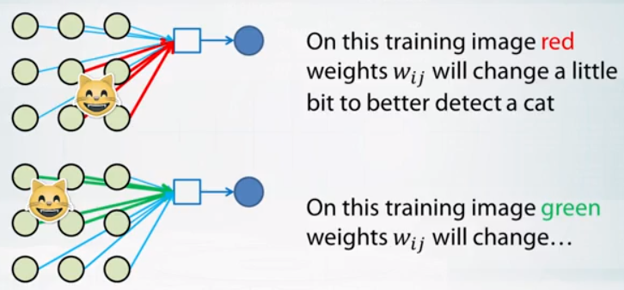
Neural Networks: Limitation IV
Image Classification:
What if we use a normal full-connected neural network to do classification?
We split the whole image into multiple pixels. Each pixel (a value to represent darkness or brightness of color: 0 to 255) is one feature.
What is wrong here ?
We don’t fully utilize the training data
What if in test data, the cat is in other areas (e.g., in the centre of the image)?

Slide 28
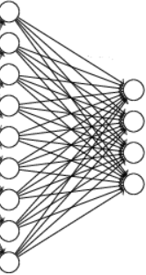

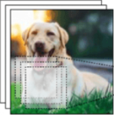
Neural Networks: Limitation IV
Image Classification:
Fully-Connected Neural Network in Computer Vision:
Slow
Overfit
Fully Connected Normal NN
300*300*4+1
About 360,001 weights
300*300 inputs
Suppose you have four neurons in the hidden layer

Slide 29
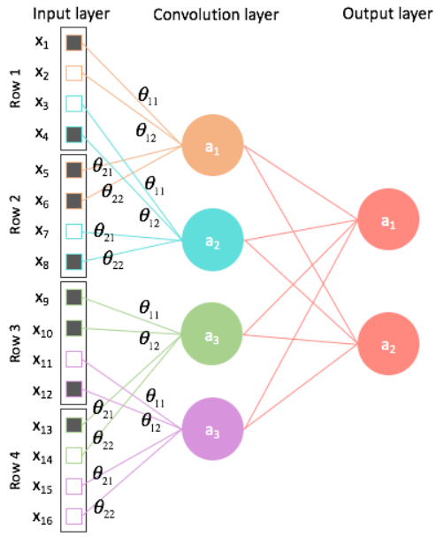
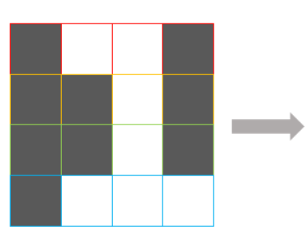
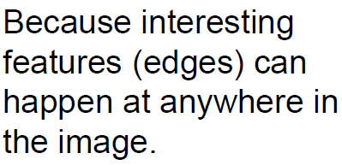
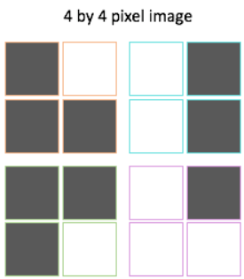
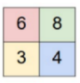


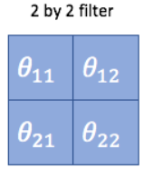
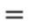
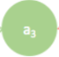

Neural Networks: CNN
Local/Sparse Connectivity:
Sharing weights
Convolutional Neural Networks:
Spatially organized
Convolution Layer (Filter/Kernel):
Suppose Slide Stride=2
Feature Map:
with new “pixels”

Slide 30
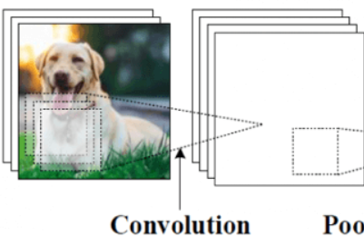
Neural Networks: CNN
Convolutional Neural Networks
Fully Connected Normal NN
CNN
300*300*4+1
About 360,001 weights
(5*5+1)*4
Only 104 weights
300*300 inputs
300*300 inputs
Suppose you have four neurons in the hidden layer
Suppose you have four 5*5 kernels in the convolution layer

Slide 31
Neural Networks: Alternative Variants
Recurrent Neural Networks (RNN)
Time-dependent Neuron States
Long-Short-Term-Memory (LSTM)
Restricted Boltzmann Machine (RBM)
Deep Belief Network (DBN)
Auto-Encoder
More…

Slide 32
Neural Networks:
Applications in IS Research

Slide 33

Neural Networks: Applications
Academic Research
Shunyuan Zhang, Dokyun Lee, Param Vir Singh, Kannan Srinivasan. How Much is an Image Worth? Airbnb Property Demand Analytics Leveraging A Scalable Image Classification Algorithm. Working Paper. (https://papers.ssrn.com/sol3/papers.cfm?abstract_id=2976021)
Question: What is the effect of joining Airbnb photography program (i.e., verified photos)?
Training: Label image quality on Amazon Mechanical Turk
CNN (VGG-16): Image quality and (12) interpretable image features

Slide 34
Neural Networks: Applications
Computer Vision
Image Classification, Face Recognition, Object Detection
Video Mining
Natural Language Processing
Textual Feature Extraction (e.g., Content features, sentiment/semantic features, etc.)
Time Series Forecasting
Speech Recognition
More…
Remember:
Earn money and Buy GPUs

Slide 35
One Sentence for Machine Learning And Deep Learning
In God we trust, all others bring data
------William Edwards Deming (1900-1993)
From “The Elements of Statistical Learning” (ESL) by Trevor Hastie, Robert Tibshirani and Jerome Friedman

Slide 36
Thank You !

